Slide 1
多体問題の計算科学
#1
2017/4/11
Computational Science for
Many-Body Problems
1. Background of the lecture
2. Many-body problems in physics
3. Computational science of many-body problems
4. Matrix and Discretization
5. (Super)computers
6. Preliminary: Quantum many-body problems
7. Details and exercises

Slide 2



Background of This Lecture
Related lecture
UTokyo
Computational Science Alliance
物質科学のための計算数理I (金曜３限)
exercise
Post-K project
Priority Issue on Post-K computer
“Creation of New Functional Devices and
High-Performance Materials to Support
Next-Generation Industries”
Exploratory Challenge on Post-K computer
“Frontiers of Basic Science:
Challenging the Limits”

Slide 3
Background of Lecturers
山地 洋平 YAMAJI, Youhei
(Project Associate Professor,
Eng. Bldg. #6, 422)
Related lecture
物質科学のための計算数理I (金曜３限)
exercise
Research:
Theoretical condensed matter physics
Computational method of many-body quantum systems
Developer of open source codes for supercomputers
Quantum lattice model solver HΦ
http://ma.cms-initiative.jp/ja/index/ja/listapps/hphi

Slide 4
Computational Science
1st Experimental Science
2nd Theoretical Science
3rd Computational Science
4th Data Science
Computational Science 計算科学
Computer Science 計算機科学

Slide 5
Computational Science Education

Slide 6

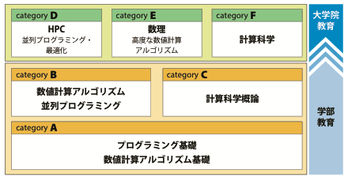
計算科学アライアンス認定講義
実習にも力点をおいた新しい講義を立ち上げ
計算科学・計算機科学に関する80以上の学部・大学院講義とあわせ、 「計算科学アライアンス認定講義」として体系化
認定講義を内容に応じて6つのカテゴリに分類
所定の単位を取得した学生には「修了認定証」を発行
学部
カテゴリA,B,Cからそれぞれ1.5単位以上
大学院
カテゴリD,E,Fのうち2つのカテゴリを選択しそれぞれから2単位以上

Slide 7
アライアンス認定講義 - 学部
カテゴリA - 計算機システムの使い方、CやFortranなどプログラミング言語の基礎。常微分方程式、連立方程式、固有値問題の解法、データ統計処理など、基礎的な数値計算アルゴリズム
例) 計算機実験I,II (3年夏冬)
カテゴリB - より高度な数値計算アルゴリズム。疎行列に対する反復解法、クリロフ部分空間法、偏微分方程式の基礎解法、モンテカルロ法、最適化問題
例) 連続系アルゴリズム (4年夏）
カテゴリC - さまざまな分野で行われている研究やシミュレーション手法。実際にソフトウェアを用いて計算科学シミュレーションを体験
例) 計算科学概論 (4年夏)

Slide 8
アライアンス認定講義 - 大学院
カテゴリD - 最先端のスーパーコンピュータを駆使するのに必要とされる技術。種々の並列アルゴリズム、MPI並列やOpenMP並列などの並列プログラミング、メモリアクセス最適化などのチューニング技術
例) 物質科学のための計算数理I
カテゴリE - 最先端の数値計算アルゴリズムとその数理的基礎付け。差分法・有限要素法・有限体積法、特異値分解、最適化問題などの手法とその応用
例) 計算科学における情報圧縮
カテゴリF - 各分野におけるシミュレーション手法とその研究成果。電子状態計算、分子動力学、量子多体計算、数値流体力学、構造計算、ゲノム解析など

Slide 9
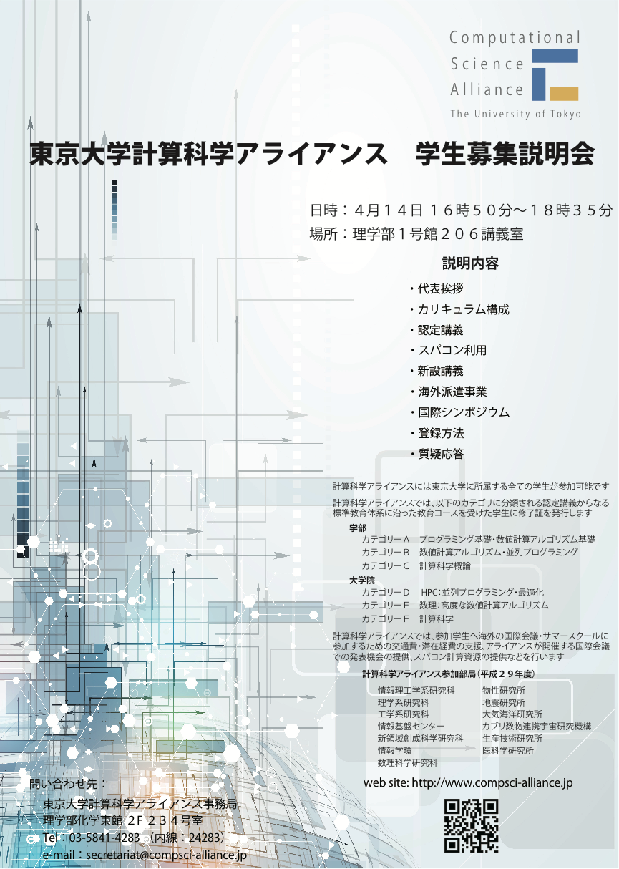
アライアンス 学生募集説明会
4月14日(金) 16:50〜 ＠ 理学部1号館 206講義室
説明内容
カリキュラム構成・認定講義・登録方法
海外派遣 - 海外の国際会議における研究発表、サマースクール等への参加、大学・研究機関における国際共同研究などの必要経費を支援
スパコン利用 - 情報基盤センターのスパコンを研究・教育に利用
国際シンポジウム
詳細は http://www.compsci-alliance.jp/

Slide 10
Computational Science Education
Category F Computational Science
計算科学の各分野におけるシミュレーション手法と
その研究成果について学ぶ。
電子状態計算、分子動力学、量子多体計算、数値流体力学、
構造計算、ゲノム解析など、さらには社会科学や経済分野
における最先端手法を学習する。
また、実際にソフトウェアを用いて大規模計算科学
シミュレーションを実行する

Slide 11
Many-Body Problems
Many-body problems in Physics
Examples:
-Celestial objects
-Proteins and molecules
(molecular mechanics, quantum mechanics/molecular mechanics)
-Electrons in molecules and solids
-Quantum Chromodynamics
Principles:
・Classical mechanics
(Newtonian equation of motion, Post Newtonian, …)
・ Quantum mechanics
(Schrödinger equation, …)
・ Classical/quantum statistical mechanics

Slide 12
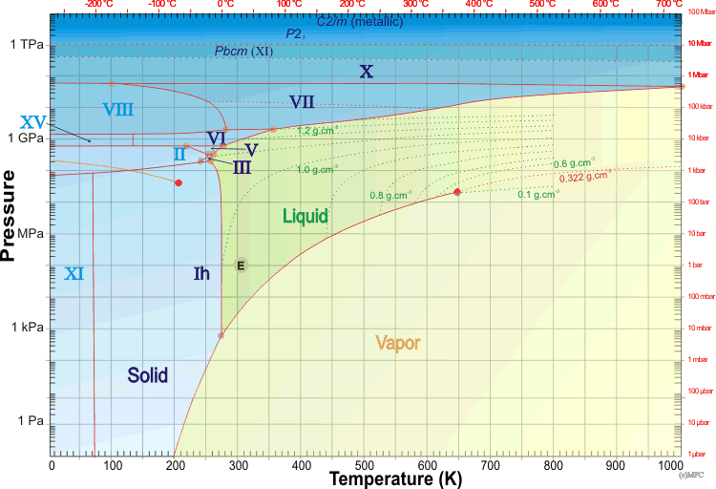
An Example of Many-Body Problems: H₂O
Phase diagram of H₂O
Martin Chaplin
Water Structure and Science
http://www1.lsbu.ac.uk/water/

Slide 13
An Example of Many-Body Problems: Proteins
Proteins in water
David E. Shaw et al.,
D. E. Shaw Research
SC09 (2009)

Slide 14
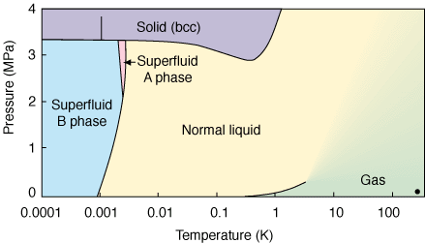
An Example of Many-Body Problems: Quantum Liquids
Phase diagram of ³He
D. D. Osheroff, R. C. Richardson, and D. M. Lee,
Phys. Rev. Lett. 28, 885 (1972).
Erkki Thuneberg
http://ltl.tkk.fi/research/theory/helium.html

Slide 15
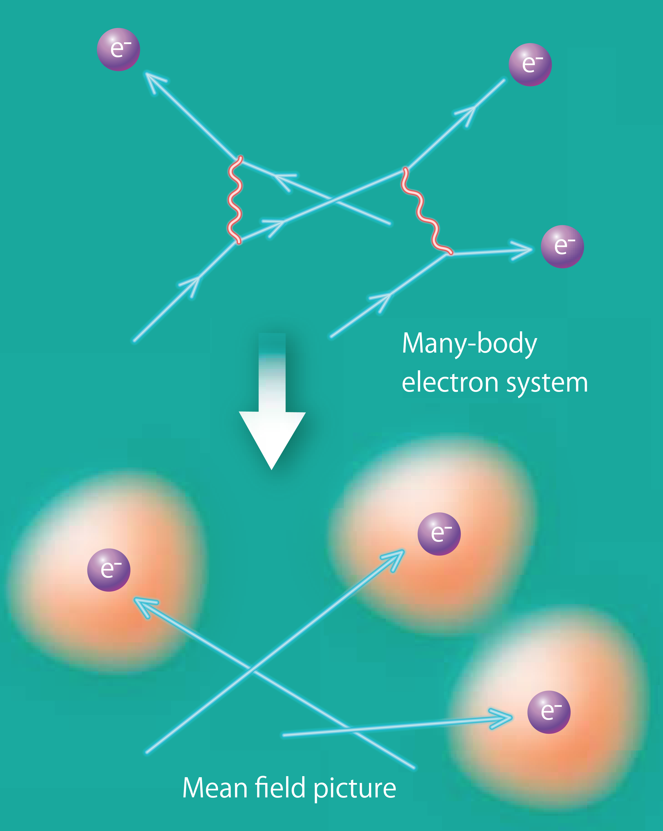
Many-Body Problem & One-Body Picture in Solid State Physics
Basis of quantum many-body problem
Hartree-Fock (Mean-field)
Landau’s Fermi liquid (1956)
Hohenberg-Kohn
& Kohn-Sham theory (1965)
Trend after Landau & Kohn
Ab initio
LDA, GGA, HF
Model calculations
Hubbard model, Heisenberg model,…
ED,QMC,DMFT,…
cf.) Solvable model
Recent trends
“One-body picture”
GW, post HF, LDA+DMFT, GW+DMFT…

Slide 16
Model of Many-Body Electrons
One of the simplest many-body electrons in
Crystalline solids: Hydrogen solid
Gedankenexperiment of F. N. Mott

Slide 17
Matrix and Discretization

Slide 18
From Tentative Lecture Schedule
第１回： 物理学における多体問題
第２回： 多体問題における困難
第３回： 古典統計力学模型と数値計算
第４回： 古典モンテカルロ法とその応用
第５回： 分子動力学法とその応用
第６回： 拡張アンサンブル法によるモンテカルロ計算
第７回： 量子統計力学模型と数値計算
第８回： 量子モンテカルロ法
第９回： 量子多体問題と線形代数
第１０回： 巨大な疎行列に対するクリロフ部分空間法
第１１回： クリロフ部分空間法の量子多体問題への応用
第１２回： クリロフ部分空間法による量子統計力学
第１３回： 量子多体問題の並列計算アルゴリズム
Classical
Quantum
One-body
Many-body

Slide 19
Classical vs Quantum
Hamiltonian matrices
classical
quantum
One-body
Many-body

Slide 20
Rewriting Equations
We need to rewrite first principles equations
to calculate them in suitable and efficient way
with (super)computers
A typical example: Discretization
Differential equation
Difference equation
Other examples: Symplectic integral, variational methods, …

Slide 21
Difference and Differential: Diffusion Eq.
Difference eq.
Differential eq.

Slide 22
Computer

Slide 23
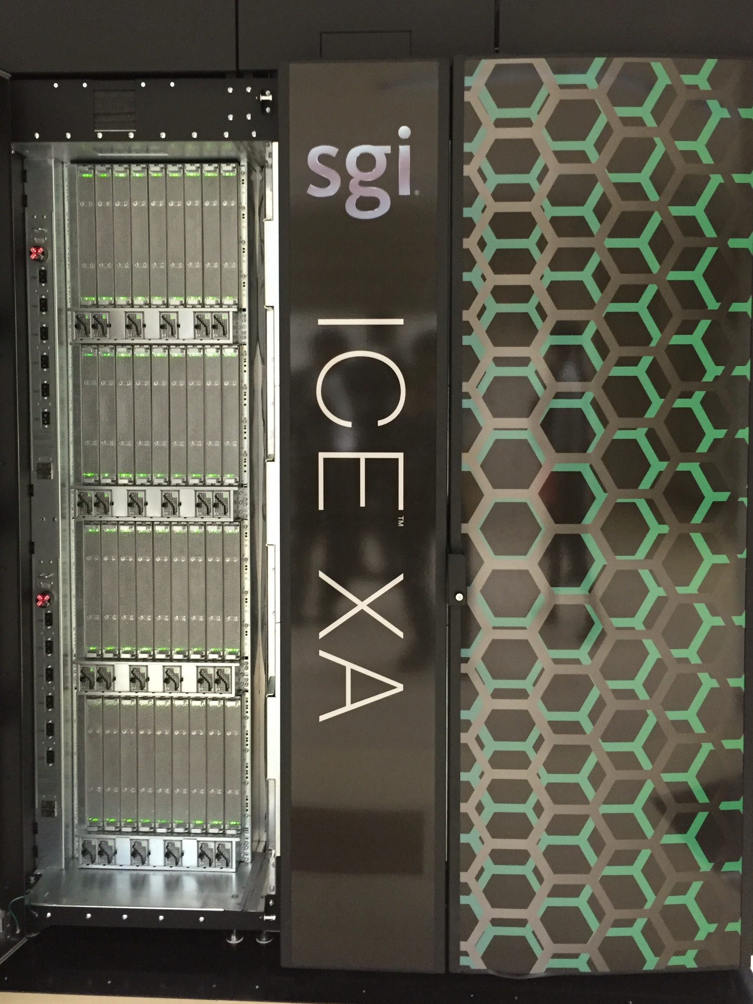
Supercomputers in UTokyo
Oakforest-PACS
JCAHPC@Kashiwa (Utokyo & Tsukuba U)
The fastest in Japan (6th in TOP500)
Theoretical Peak: 24,913.5TFlop/s (13,554.6TFlop/s)
Intel Xeon Phi 7250 (1.4GHz, 68 cores, 112GB)
8,208 nodes
Sekirei
ISSP, UTokyo@Kashiwa
10th in Japan (86th in TOP500)
Theoretical Peak: 1,520.64TFlop/s
(1,178.3TFlop/s)
Intel Xeon E5-2680v3 (2.5GHz, 24 cores, 128GB)
1,584 nodes

Slide 24
Performance of computer
How many times does the computer multiply/add per second?
How much data does the computer memorize?
How much data does the computer read/write per second?

Slide 25
Numbers in Computers
Integer
Integer(4): 31bit+1bit
Real number
IEEE Std 754-2008 binary64
(double-precision floating-point number)
Double precision/real(8):
Sign (1 bit) + Exponent (11 bit) + Significand (52 bit)

Slide 26
FLOP/s
Floating-point Operations Per Second
An example: Intel Xeon Phi Nights Landing
Intel Xeon Phi 7250 (1.4GHz, 68 cores, 112GB)
-1.4 × 10⁹ instructions per second
-Intel AVX-512 instruction
double precision floating point number (8byte=64bit)
8 double-precision multiply-add operations
→ 1.4 × 10⁹ × 16 × 68 FLOP/s per processor
cf.) Multiply-add:

Slide 27
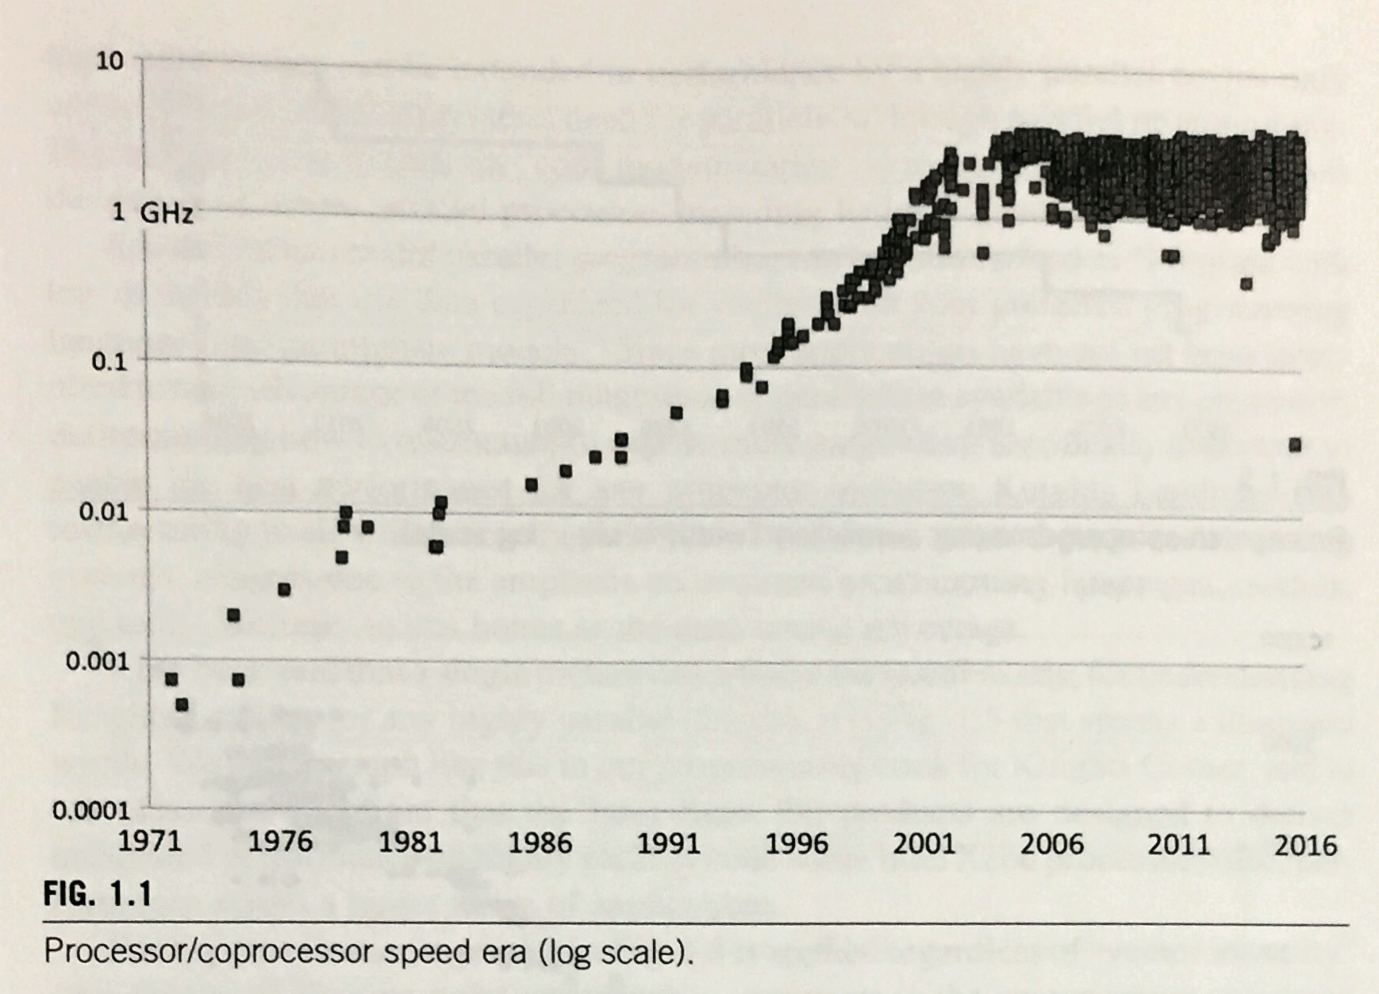
Increasing FLOP/s
Clock rate saturated
J. Jeffers, J. Reinders, and A. Sodani,
Intel Xeon Phi Processor High Performance Programing

Slide 28
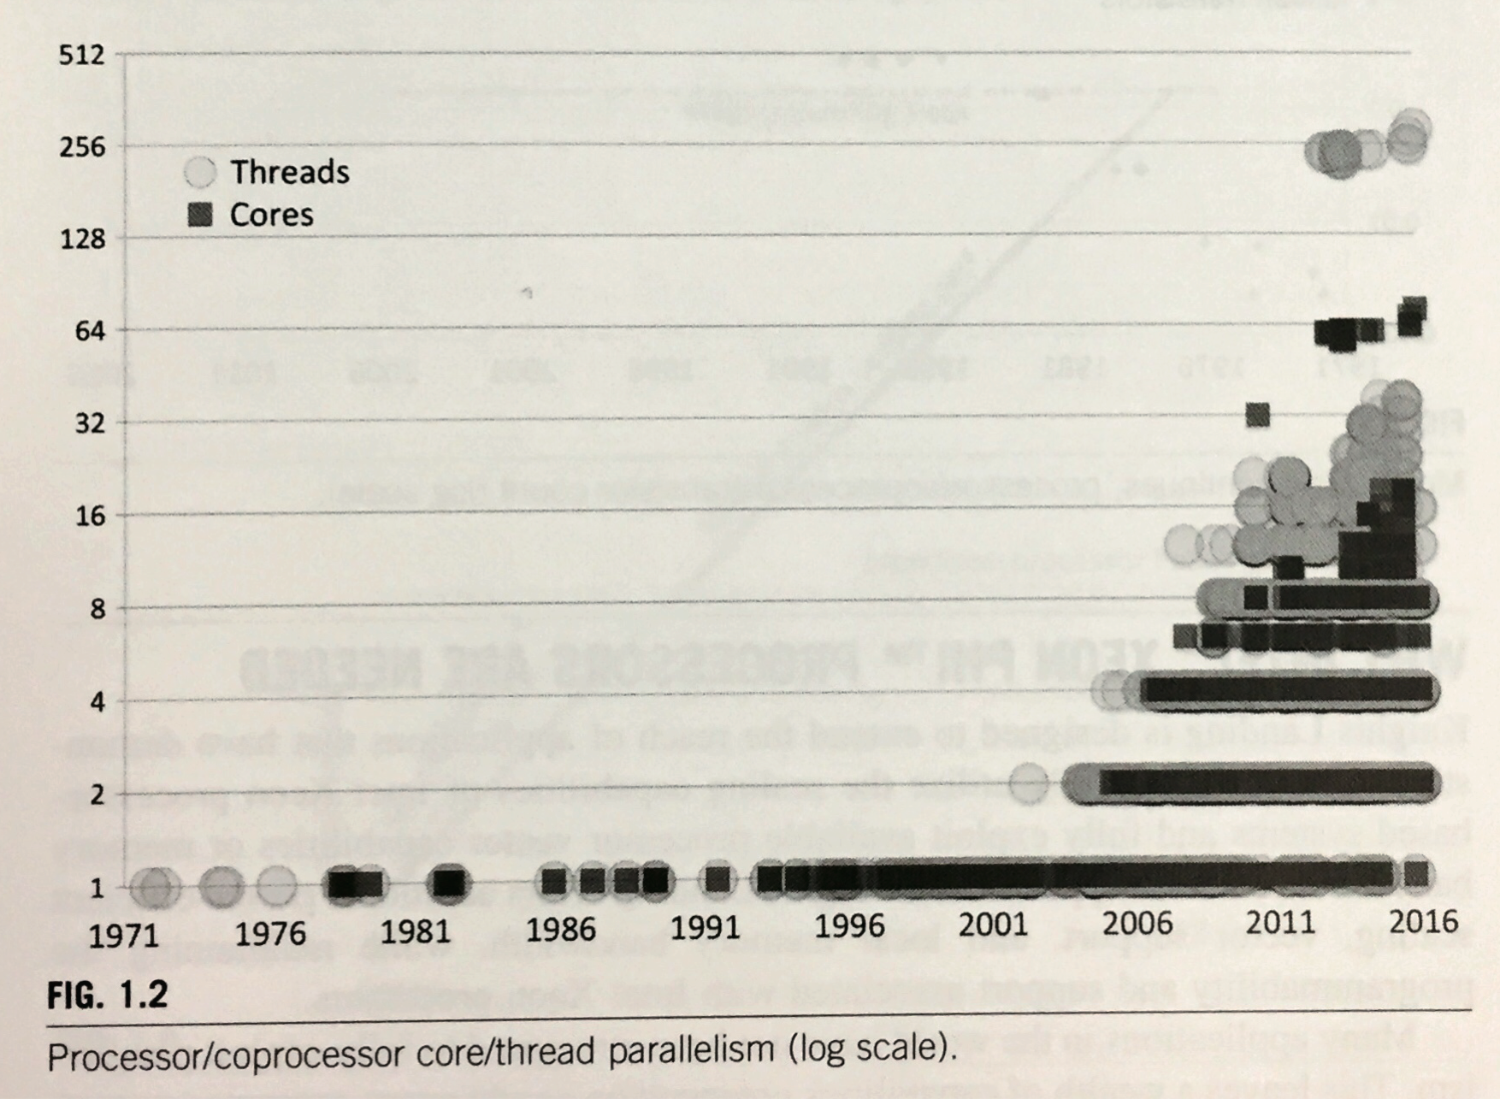
Increasing FLOP/s
Number of cores
J. Jeffers, J. Reinders, and A. Sodani,
Intel Xeon Phi Processor High Performance Programing

Slide 29
Performance of computer
How many times does the computer multiply/add per second?
How much data does the computer memorize?
How much data does the computer read/write per second?

Slide 30
Cache, Memory, and Disk
few
10-20
hundreds cycles
FPU
register
L1
L2
Memory
Hierarchy:
Register
L1 Cache
L2 Cache
Memory
Disk
Network
Intel Xeon Phi 7250
32KB per core
512KB per core
〜1.6GB per core (〜10GB/s per core)
Byte per flop (B/F)

Slide 31
Preliminary: Quantum Many-Body Problem

Slide 32
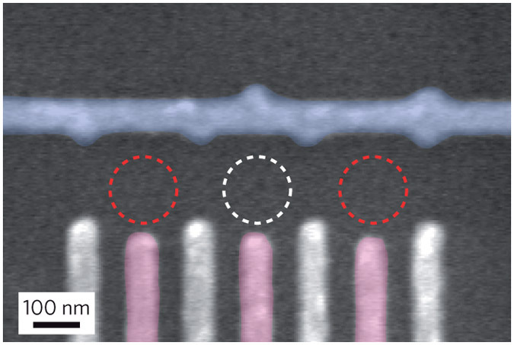
Quantum Many-Body Problems
An example: 3 Quantum dots
F. R. Braakman, et al., Nat. Nano. 8, 432 (2013)
Quantum dot:
-A quantum box can confine a single electron
-Utilized for single electron transistor, quantum computers
One-body problem:
One electron confined in three quantum dot
→ Number of states = 2×3 (factor２ from spin)

Slide 33
Quantum Many-Body Problems
An example: 3 Quantum dots
F. R. Braakman, et al., Nat. Nano. 8, 432 (2013)
量子ドット:
-電子１つを閉じ込めることができる“箱”
-1電子トランジスタや量子コンピュータを
作るための量子ビットとして使われる
Quantum dot:
-A quantum box can confine a single electron
-Utilized for single electron transistor, quantum computers
Three-body problem:
→ Number of states = 2³ (factor２ from spin)
States represented by
superposition

Slide 34
Quantum Many-Body Problems
N Quantum dots
One-body problem:
→ Number of states = 2×N
N-body problem:
→ Number of states = 2^{N}
Further example: N=12
One-body problem→ Number of states = 2×N = 24
N-body problem→ Number of states = 2^{N} = 4096
Extreme example: N=36
One-body→ 2×N = 72
N-body→ 2^{N} 〜 6.9×10¹⁰

Slide 35
Method of Evaluation
Based on 3 Reports:
-Exercise about algorithms
-Exercise of computer simulation
Closely Related Lectures
・物質科学のための計算数理I (S1S2), II (A1A2)
Fri. 3rd period
-Exercise of computer simulation
・計算科学概論 (for undergraduate)
Mon. 3rd period
・(archive/seminar)計算科学科学技術特論A,B,C

Slide 36
Exercises (Not report problems)
1. Status of N qubits is represented as
a complex vector in 2^{N}-dimensional Hilbert space.
If you can use whole system of Oakforest-PACS,
how many qubits can you store in the memory?
2. Usually, B/F of modern supercomputers
is less than 1.
Which kind of calculations is suitable for them?

Slide 37
Quantum Lattice Model Solver HΦ
HΦ developers:
Taka Misawa, Kazu Yoshimi, Mitsu Kawamura,
Naoki Kawashima (ISSP)
Synge Todo (Department of Physics, UTokyo)

Slide 38
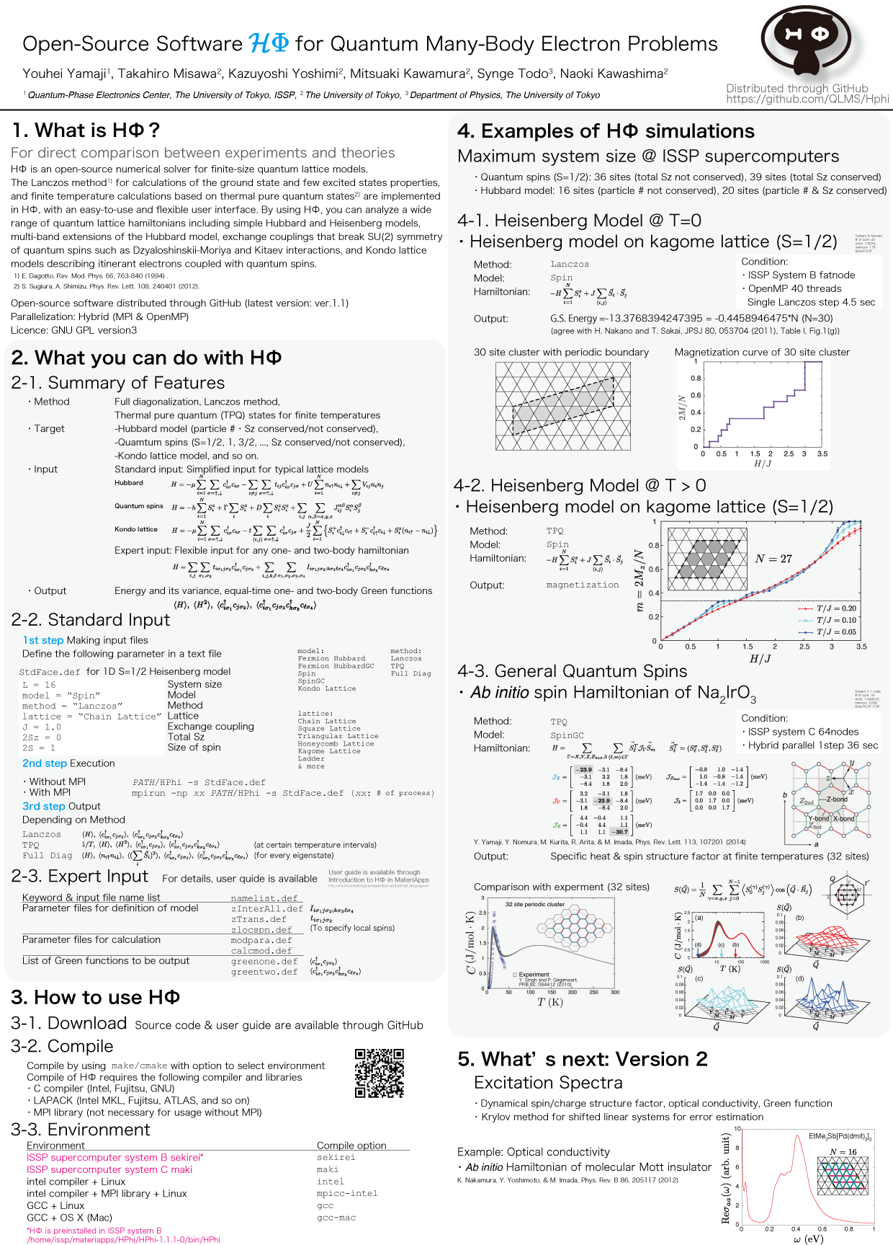
What is HΦ?
有限温度計算手法: TPQ
Please see our poster
(a letter-size hard copy
is distributed in the lecture)

Slide 39
How to Get and Install HΦ
有限温度計算手法: TPQ
Q. Where can you get HΦ？
A. Materiapps or Github
http://ma.cms-initiative.jp/en/application-list/hphi?set_language=en
https://github.com/QLMS/HPhi
Q. What does HΦ require?
A. C compiler and Lapack.
If you have MPI library, you can enjoy larger simulation
Q. How to install HΦ?
A. Let’s install with me!

Slide 40
How to Use HΦ
有限温度計算手法: TPQ
・We have 2 modes of preparing input files
-Standard mode
Execution

Slide 41
How to Use HΦ
・Parameters in StdFace.def
Periodic boundary condition!

Slide 42
PC Cluster mars and Tips on Unix Commands

Slide 43
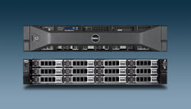
PC Cluster mars
Login node: mars
Computing node: mars01,mars02,…,mars10
Intel Xeon X5675 3.06GHz, 6 core, 2 CPU
mars01
120 cores in total
CPU
CPU
core1
core2
core1
core2
core3
core4
core3
core4
core5
core6
core5
core6
memory 24GB

Slide 44
PC Cluster mars
Login node: mars
IP address: 133.11.72.58
(visible only within UTokyo)
Remote login by ssh
$ ssh –Y –l username 133.11.72.58
$ ssh –Y username@133.11.72.58

Slide 45
Where are you? pwd
$ pwd
/home/Student/username
What are there? ls
$ ls
NVIDIA_GPU_Computing_SDK qsubsamples WIEN2k
Walk around cd
$ cd ..
$ pwd
/home/Student
$ cd ./username
$pwd
/home/Student/username

Slide 46
Make new directory mkdir
$ pwd
/home/Student/username
$ mkdir exercise
$ cd ./exercise
Copy files/directories cp (-r)
$ cp –r /home/Student/Public/101212 ./.

Slide 47
Write a Program and Execute It
$ vi hello.f90
program hello
implicit none
write(*,*) "Hello world!”
end program hello
$ gfortran hello.f90
$ ./a.out
Hello world!
Login node mars Executed at mars
Computing node mars01, …

Slide 48
Execute Jobs with Job Scheduler
Job submission: Submit job script to scheduler
$ qsub ./sub.sh
sub.sh
#!/bin/sh
#$ -S /bin/sh
#$ -cwd
#$ -V
#$ -q gr1.q@mars01
#$ -pe smp 1
export OMP_NUM_THREADS=1
./a.out > log
← submit job to mars01
←Standard output in a file “log”
Login node mars
Computing node mars01, … Executed at mars01

Slide 49
Let’s Install HΦ!

Slide 50
Many-Body Problems in Solid State Physics

Slide 51
Many-Body Problems in
Solid State Physics
Size of problems Classical or quantum
Example: N bits
● Classical: 2N dimension
● Quantum: 2^{N} dimension
★ Classical molecular dynamics
〜10⁷ atoms, 〜20μs/day
All atoms in a virus > 1,000 atoms, folding of protein 1μs〜1ms, 1s
Ref. パリティ Vol.28 No.07
吉井先生(名大)の配信講義も参照
http://www.cms-initiative.jp/ja/events/CMSI_events/2013_haishin
★ Quantum spins (numerical exact simulation)
〜40 spins (double precision wave function = 8TB)

Slide 52
Numerical Methods for
Quantum Many-Body Problems in CMP
■ Numerical exact diagonalization: Lanczos method (Krylov subspace)
Ground state and low-lying excited states
(equivalent to full CI)
■ Quantum Monte Carlo:
Hirsch-Fye, World line, CTQMC, AFQMC, PQMC, DQMC, …
Negative sign problem
■ Matrix/Tensor Product State:
DMRG, NRG, MPS, TN, MERA, …
■ Negative-sign-free Quantum Monte Carlo:
Green’s function Monte Carlo
Fixed node *DFT/LDA E_{XC}[ρ] was derived by these techniques
Variational Monte Carlo
Biased by initial wave function
■ Dynamical mean-field theory:
Lanczos method, Hirsch-Fye QMC, CTQMC, NRG, …
No spatial fluctuations
(Similar to MRCI?)
■ One-body approximation or mean-field (Hartree-Fock, …)

Slide 53
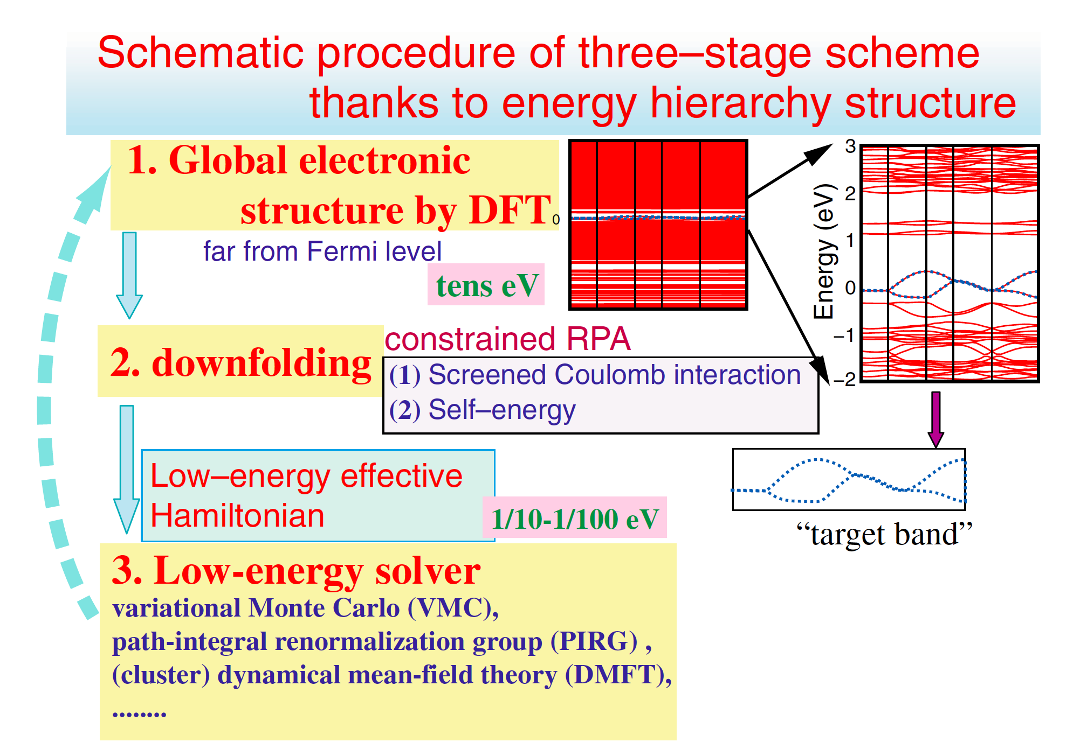
Target of Model Calculations
■ Ising model
-Rare earth magnets
■ Heisenberg model
-Transition-metal oxides
■ Hubbard model (Gutzwiller, Kanamori)
-Itinerant magnets, Mott insulators
■ t –J model
-Cuprate superconductors
■ Kondo model and Anderson model
-Magnetic inpurities in alloys
-Rare earth alloys
Model Hamiltonian derived by
DFT+DMFT, Wannier+cRPA
G. Kotliar, et al., RMP 78, 865 (2006)
M. Imada & T. Miyake, JPSJ 79, 112001 (2010)

Slide 54
Model of Many-Body Electrons
One of the simplest many-body electrons in
Crystalline solids: Hydrogen solid
Gedankenexperiment of F. N. Mott

Slide 55
One of the Simplest Model: 1D Hubbard Model
-Tunnelling among neighboring 1s orbitals
-Intra-atomic Coulomb in 1s orbitals
1D Hubbard model (periodic boundary condition, L site)
cf.) Bethe ansatz, Tomonaga-Luttinger liquid

Slide 56
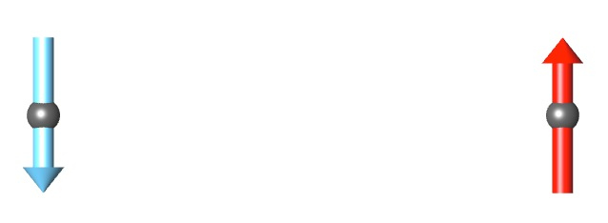
Hydrogen Molecule
H₂
UHF-type wave function
Hubbard model
cf.) Chiappe et al., Phys. Rev. B 75, 195104 (2007)
Heisenberg model or J-coupling
Singlet ground state
Notes:
Distance between two hydrogen atoms becomes larger
Singlet formation is quite clear in the Heisenberg model

Slide 57
Strong Coupling Limit of Hubbard Model & Parallelization (Next Week)

Slide 58
山地 洋平 Yamaji, Youhei
(MERIT project lecturer, Eng. Bldg. #6, 422)
◎ Administrator of PC cluster mars
yamaji@ap.t.u-tokyo.ac.jp
◎ Research field ーTopological and dynamical properties of
strongly correlated electrons
Target: Itinerant electron magnets, Mott insulators, topological states of matters
ZrZn₂, YbRh₂Si₂, cuprates, A₂IrO₃, R₂Ir₂O₇
◎ Developing apps for parallelized computers
Quantum lattice model solver HΦ
http://ma.cms-initiative.jp/ja/index/ja/listapps/hphi

Slide 59
Energy Spectrum of the Two Spins
Problem 2: Diagonalize 4 by 4 Hamiltonian matrix

Slide 60
Answer of the Problem 2:
Energy Spectrum of the Two Spins

Slide 61
Quantum Many-Body Problems
Mutual Interactions
1. Operators acting on
a single qubit
A two dimensional representation of Lie algebra SU(2)

Slide 62
Quantum Many-Body Problems
Mutual Interactions
Fock space of N qubits:
Operators acting on N-quibit Fock space:

Slide 63
Quantum Many-Body Problems
Quantum entanglement
Example: Two qubits
-Superposition
-Utilized for quantum teleportation
cf.) EPR “paradox”
Mutual interactions between two qubits
→Superposition

Slide 64
Hamiltonian Matrix
Example: N qubits
N-qubit Fock space:
Mutual interactions among N qubits:
Hamiltonian operator

Slide 65
Vectors in Fock Space
Correspondence between spin and bit
2^{N}-dimensional Fock space:
Decimal representation of orthonormalized basis
Wave function as a vector

Slide 66
Vectors and Matrices in Fock Space
Inner product of vectors
Hamiltonian matrix
Orthonomalized basis:

Slide 67
Example: Two Spins
Decimal representation of orthonormalized basis
Problem: Find 4 by 4 Hamiltonian matrix that describes
Useful transformation:
Ladder operators

Slide 68
Answer of the Problem
Matrix element
4 by 4 Hamiltonian matrix

